Slide 1
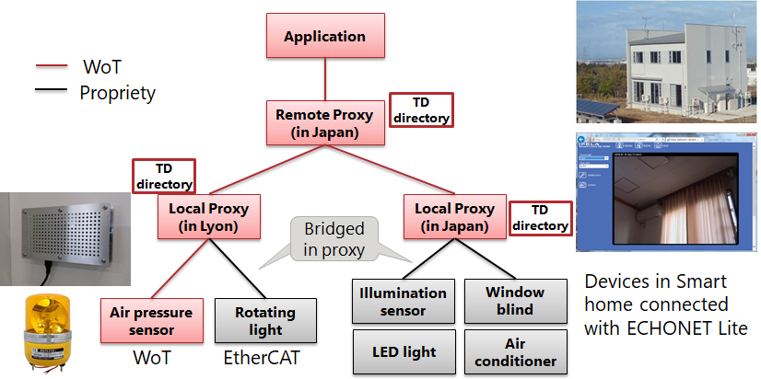
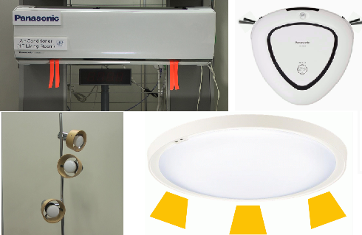
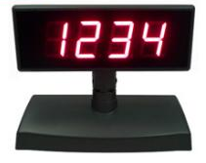
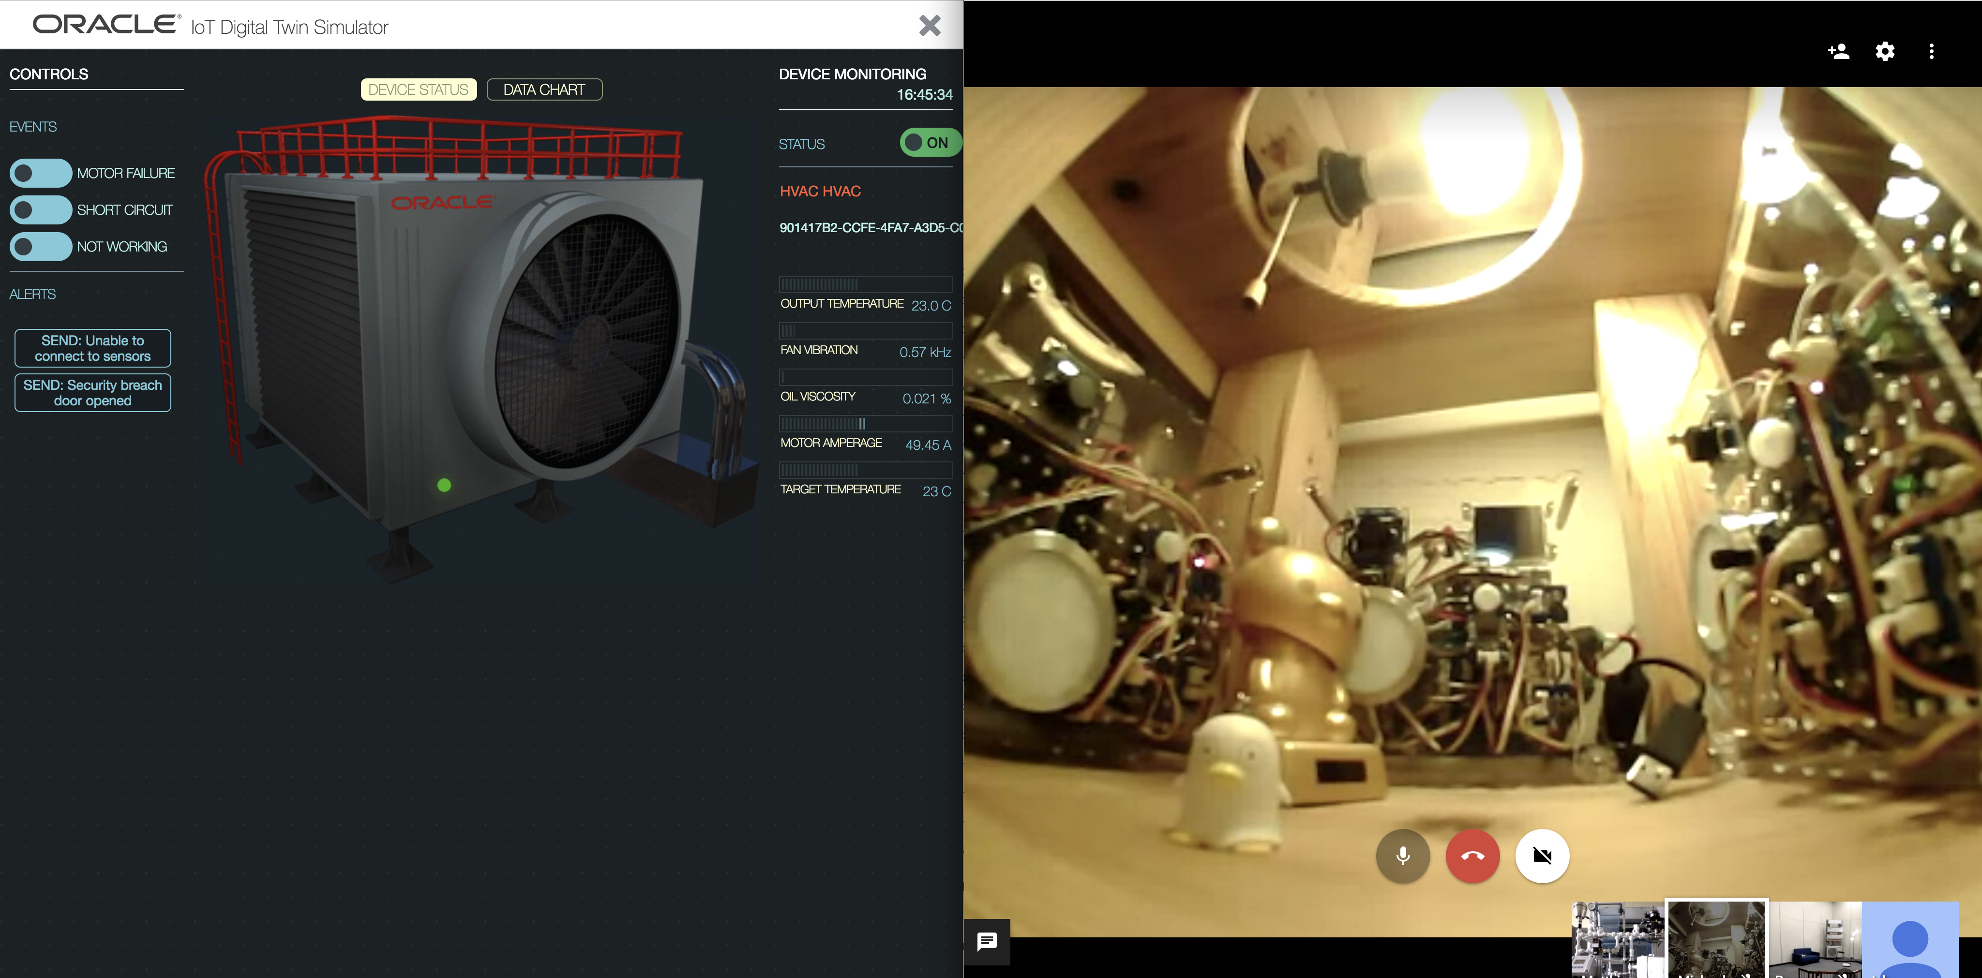
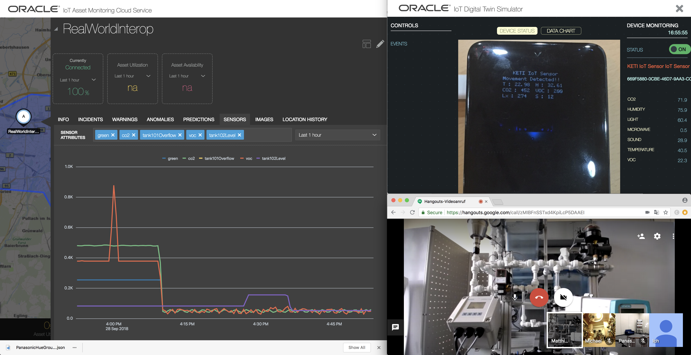
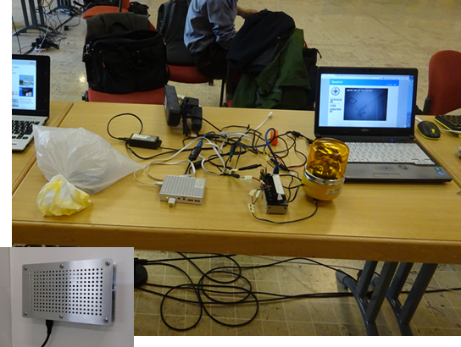
Kanazawa
Osaka
Fujitsu
Smart Meter
Fujitsu
LED Light
Panasonic
Air Con.
Panasonic
Cleaner
Fujitsu
Blind (open)
Fujitsu
Blind (close)
Panasonic
B. Board 1
Panasonic
B. Board 2
Fujitsu
Local Proxy
Fujitsu
Air Conditioner
Panasonic
Hue
Cloud
Fujitsu
Remote Proxy
Oracle
HVAC D.T. Sim.
Oracle
Blue-Pump D.T. Sim.
Oracle
Festo Plant D.T. Sim.
Oracle
Solar Panel D.T. Sim.
Siemens
Charging Integration
Oracle
IoT Cloud Service
Fujitsu
Remote Proxy
Panasonic
Air Con. (Sim.)
Panasonic
Cleaner (Sim.)
Panasonic
Hue (Sim.)
Panasonic
Room Light (Sim.)
Fukuoka
Mozilla
WebThings Gateway
Fujitsu
Local Proxy
Panasonic
B. Board 3
Panasonic
Google Home
NHK
Hybridcast TV
Mozilla
Applications
Panasonic
Air Con. (Sim.)
Panasonic
Cleaner (Sim.)
Panasonic
Hue (Sim.)
Panasonic
Room Light (Sim.)
Intel
Applications
Fujitsu
Applications
TU Munich
Sense HAT
NHK
Smart mirror /
refrigerator disp.
Intel
Simple Web Camera
Intel
Web Speak
Panasonic
Applications
TU Munich
Light Sensor
Fujitsu
Rotary Beacon
Fujitsu
Buzzer
Fujitsu
Env. Sensor
Fujitsu
Agri. Sensor
Fujitsu
Wearable Sensor
Hitachi
Applications

Slide 2
Scenario: Automatically turn off devices when user leaves the room (Contact: Oracle)
Kanazawa
Osaka
Fujitsu
Smart Meter
Fujitsu
LED Light
Panasonic
Air Con.
Panasonic
Cleaner
Fujitsu
Blind (open)
Fujitsu
Blind (close)
Panasonic
B. Board 1
Panasonic
B. Board 2
Fujitsu
Local Proxy
Fujitsu
Air Conditioner
Panasonic
Hue
Cloud
Cloud
Fujitsu
Remote Proxy
Oracle
HVAC D.T. Sim.
Oracle
Blue-Pump D.T. Sim.
Oracle
Festo Plant D.T. Sim.
Oracle
Solar Panel D.T. Sim.
Siemens
Charging Integration
Siemens
Charging Integration
2
Oracle
IoT Cloud Service
3
Oracle
IoT Cloud Service
4
Fujitsu
Remote Proxy
Panasonic
Air Con. (Sim.)
Panasonic
Cleaner (Sim.)
Panasonic
Hue (Sim.)
Panasonic
Room Light (Sim.)
5
6
7
Fukuoka
8
Fukuoka
Mozilla
WebThings Gateway
Fujitsu
Local Proxy
Panasonic
B. Board 3
Panasonic
Google Home
NHK
Hybridcast TV
Mozilla
Applications
1
Panasonic
Air Con. (Sim.)
Panasonic
Cleaner (Sim.)
Panasonic
Hue (Sim.)
Panasonic
Room Light (Sim.)
Intel
Applications
Fujitsu
Applications
TU Munich
Sense HAT
NHK
Smart mirror /
refrigerator disp.
Intel
Simple Web Camera
Intel
Web Speak
Panasonic
Applications
TU Munich
Light Sensor
Fujitsu
Rotary Beacon
Fujitsu
Buzzer
Fujitsu
Env. Sensor
Fujitsu
Agri. Sensor
Fujitsu
Wearable Sensor
Hitachi
Applications

